Slide 1
Analysis of Climatological Data
A Look Into 2014 Weather Trends in the USA
-Hesham Salman
-Ting Li
-Xiaoying Yu

Slide 2
Our Hypothesis
We hypothesized that elevation, latitude, and longitude had some bearing on the departure from normal temperature or precipitation.

Slide 3
Data Set
The data set is from NOAA (National Oceanic & Atmospheric Admin.)
The size of data is 4678.592KB, which contains 62,053 tuples.
The attributes of the data: station, station name, elevation, latitude, longitude, date, departure from normal monthly precipitation (DPNP), departure from normal monthly temperature (DPNT), number days in month with maximum temperature greater than or equal 90 F (DT90), number days in month with maximum temperature less than or equal 32 F (DX32).
The attributes that we’ve focused on are: elevation, Departure from normal precipitation (DPNP), and Departure from normal temperature (DPNT).

Slide 4
Adaptable of this data set
Missing data <22%
> 60,000 data records
Departure from normal temperature
adaptable
Departure from normal precipitation
temporal
spatial

Slide 5
Data Preparation
1. Missing data: 262 unknown value in elevation, longitude, latitude, and around 12759 tuples contain the missing value of DPNT or DPNP.
  (1) The rate of missing data is (262+12759)/62053*100%=21.2%
  (2) Remove the missing data tuples
2. clean data: in DPNT value set, -9999 was to represent as no difference value to compare to the mean value of each month. We instead these values into 0.

Slide 6
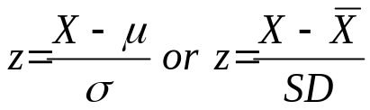
Data Normalization
1. Z-score to normalize each attribute value (elevation, DPNP, DPNT) each month:
  1). Calculate the average of DPNT/DPNP/elevation;
  2). Calculate absolute difference of each DPNT/DPNP/elevation and their average value;
  3). Calculate the average of the absolute values;
  4). Calculate Z-score.
Normalize these values into five categorical values:
  1). D PNP: very wet, wet, normal, dry, very dry
  2). DPNT: very low, low, normal, high, very high
  3). Elevation: very low, low, normal, high, very high

Slide 7
Data Analysis
Find association rules between elevation and DPNT, and between elevation and DPNP: support level 0.1, confidence:0.6
When elevation is low or normal, DPNT tends to be normal. When elevation is normal, DPNP tends to be normal.
Gantt chart is applied to display the relationship of these from January to November.

Slide 8
Data Visualization
Gant Chart is applied to do the visualization.
The x axis of Gant Chart is the months of 2014
The y axis of Gant Chart is elevation or temperature.
The rectangles that shown in the chart mean the categorical.

Slide 9
Association Rules: January
Best rules found:
1. DPNT Class= Very Cold 658 ==> Elevation Class= Normal 633 conf:(0.96)
2. DPNT Class= Cold DPNP Class= Normal 705 ==> Elevation Class= Normal 622 conf:(0.88)
3. DPNT Class= Normal Elevation Class= Normal 1624 ==> DPNP Class= Normal 1392 conf:(0.86)
4. DPNT Class= Cold 1047 ==> Elevation Class= Normal 846 conf:(0.81)
5. DPNT Class= Normal 2714 ==> DPNP Class= Normal 2178 conf:(0.8)
6. Elevation Class= Normal 3545 ==> DPNP Class= Normal 2763 conf:(0.78)
7. DPNT Class= Cold Elevation Class= Normal 846 ==> DPNP Class= Normal 622 conf:(0.74)
8. DPNT Class= Cold 1047 ==> DPNP Class= Normal 705 conf:(0.67)
9. DPNP Class= Normal 4137 ==> Elevation Class= Normal 2763 conf:(0.67)
10. DPNT Class= Normal DPNP Class= Normal 2178 ==> Elevation Class= Normal 1392 conf:(0.64)
11. Elevation Class= Low 965 ==> DPNT Class= Normal 591 conf:(0.61)

Slide 10
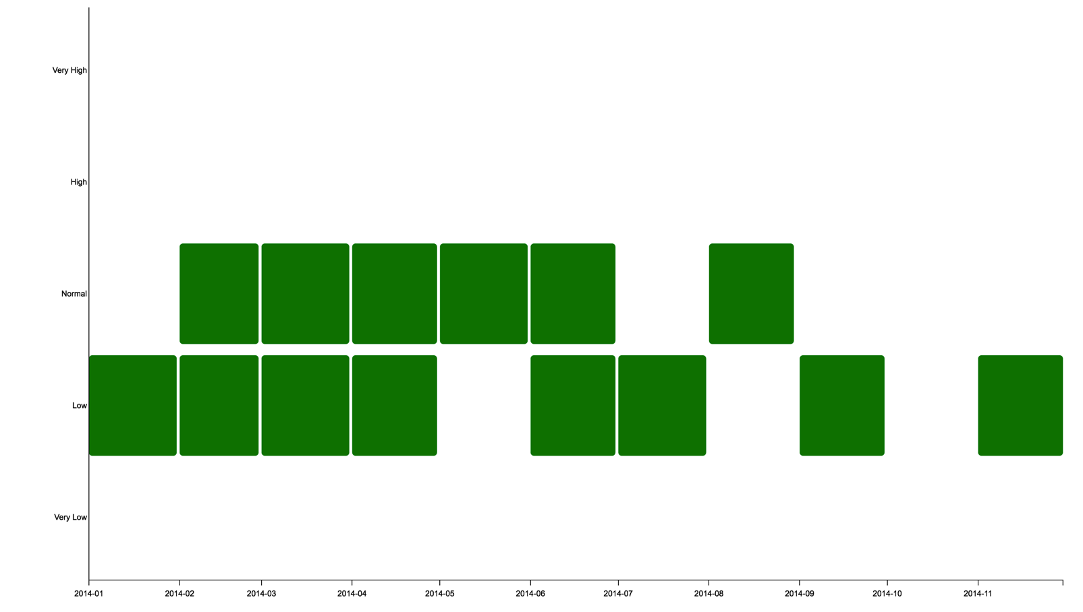
Visualization: Association Rules -- DPNT

Slide 11
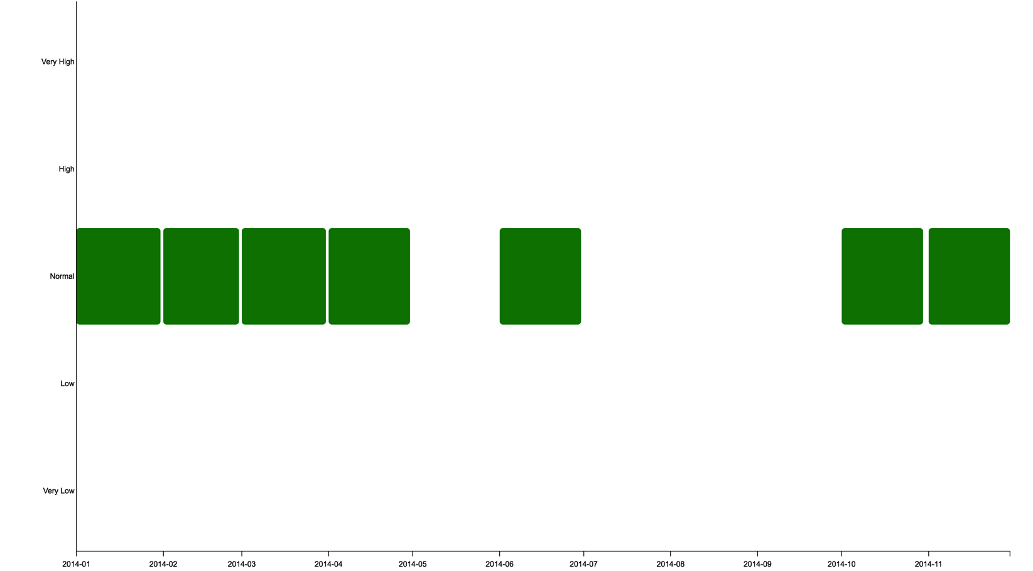
Visualization: Association Rules -- DPNP

Slide 12
Classifier
We built a classifier using our data set.
  Results indicate that our classifier can classify DPNT and DPNP correctly ~60% of the time
  When classifying Latitude, our classifier was correct ~81% of the time.

Slide 13
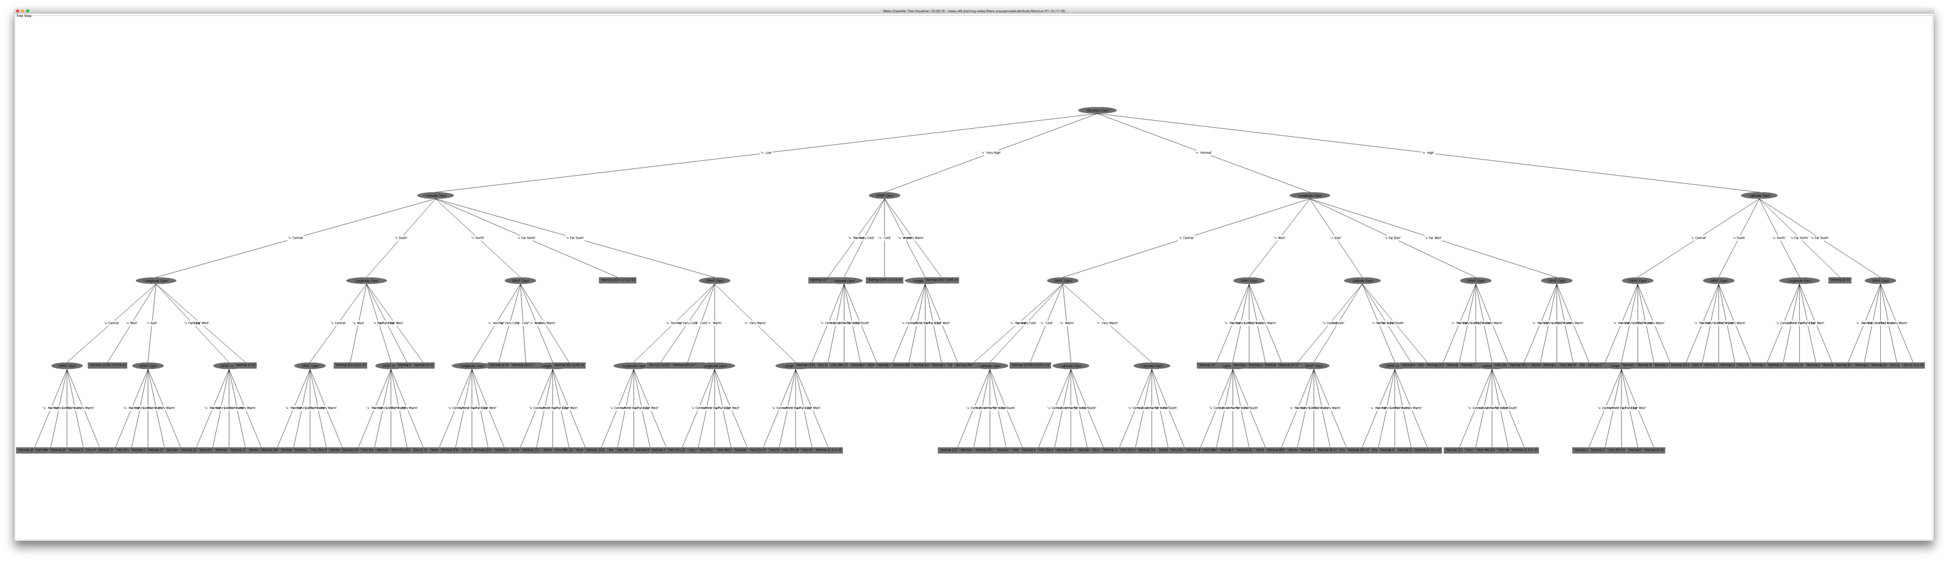
J48 Decision Tree: DPNP

Slide 14
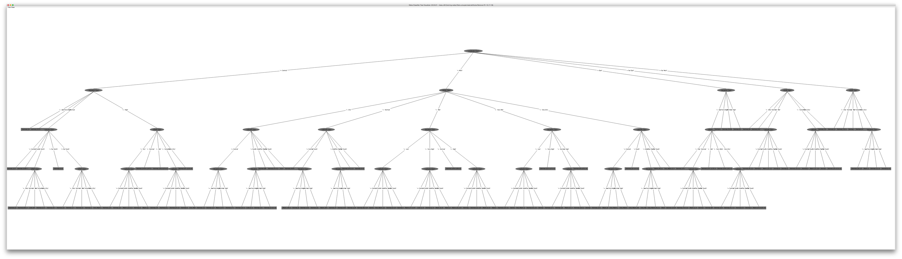
J48 Decision Tree: DPNT

Slide 15
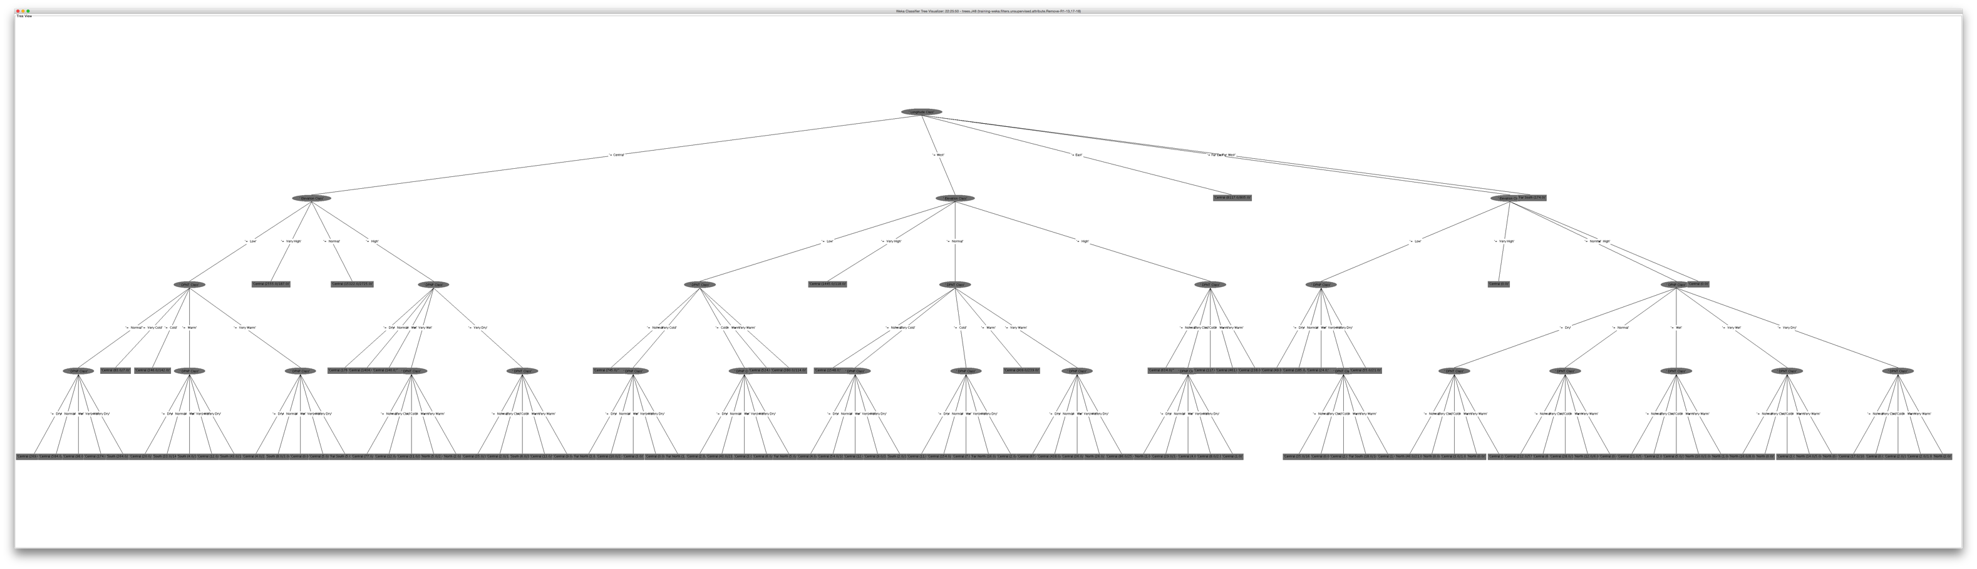
J48 Decision Tree: Latitude

Slide 16
Decision Tree Summary
Our classifier correctly classified latitude ~81% of the time.
Our classifier correctly classified DPNP and DPNT ~61% of the time.

Slide 17
Tools that We Use
Weka: association rule
Java: do normalization after we have Z score
Python: cleaning the data and converting the csv format to arff format
D3js: visualizing the data

Slide 18
Reference
1. Petterssen, Sverre. "Weather analysis and forecasting." (1940).
2. Thompson, Philip Duncan. Numerical weather analysis and prediction. New York: Macmillan, 1961.
3. Bostock, Mike. "Data-Driven Documents (d3. js), a visualization framework for internet browsers running JavaScrip t." (2012).

